Slide 1


Session 7. T24 Applications and Versions
Transact (T24) Technical Induction Training
Minsk, 2021

Slide 2




Agenda
Applications in T24
Versions Overview
Version fields. Setting Versions
Launching Versions
Zero-Auth Versions
Tabbed Screens in Versions
Workshops

Slide 3
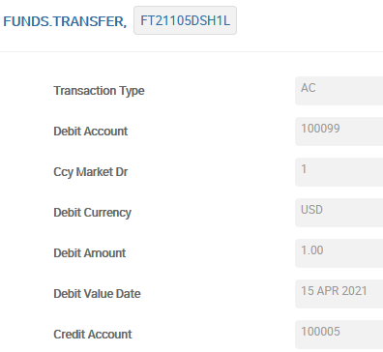

T24 Application
An application is a form which records the data entered and stores it in an associated file, field by field
FUNDS TRANSFER TABLE
@ID | Transaction Type | Debit Account | CCY Market Dr
FT21105DSH1L | AC | 100099 | 1

Slide 4

What is a Version?
What?
Version is a customised screen in T24
Allows you to default values in fields
Allows you to hide non-mandatory information
Can be created for any application in T24
Catalogued in VERSION application
Why?
To allow users to only input and view what they need for that role
Applications have a default view which displays all the fields and may confuse the user
To improve the look and feel of the system
To Control the number of authorizers
Notes:
Imagine that you have to input a funds transfer transaction in T24. You will use the FUNDS.TRANSFER application, and the input function to do so. The screen that is displayed to you contains all the fields in the FUNDS.TRANSFER application some of which may not be important to the end user. Being the first time, you cannot figure out which fields to use and which not to. What if you had a customized screen that showed you only the fields that you require to input?
You can create customized application screens in T24. They are called versions. The VERSION application must be used to create customized application screens. Your version you can have just the mandatory fields in FUNDS.TRANSFER application.
Can you view data using versions?
Versions behave like the application itself, but only look different. Thus all functions can be used with a version. So, yes you can view data using a version. Versions work with all functions of T24.

Slide 5
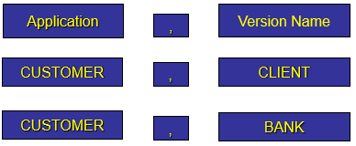
Versions
Application VERSION.
There could be many any Versions for any Application.
ID:
Notes:
Нет никаких ограничений по количеству версий на одно приложение.
Имя версии указывается через запятую после имени приложения.
Существует общее правило по которому версия с запятой (без имени) соответствует версии с нулевой авторизацией.

Slide 6
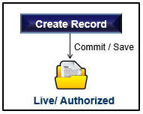
Zero – Auth Versions
Referred to as ‘Comma’ versions
Some of the default comma Versions in T24:
ACCOUNT,
FUNDS.TRANSFER,
CUSTOMER,
Records created using comma versions are self authorized
In all comma versions the NO.OF.AUTH field is set to 0 (zero)
Use ‘VERSION,’ from now on to create your versions
Credit
Officer
Notes:
Comma Versions are Auto-Auth Versions in T24.
2. Some of the comma Versions in T24, are
2.1 ACCOUNT,
2.2 FUNDS.TRANSFER,
2.3 CUSTOMER,
3. Records created using comma Versions are self-authorised records. Once you commit the records they move to LIVE status .
4. In all comma Versions the NO.OF.AUTH field is set to 0(zero). To create Zero auth versions, it is enough if we specify the name of the application in the VERSION record. Individual fields need not be added to the zero auth version. The No.of.Auth field must be set to zero.
5. VERSION, is the comma Version which is used to create auto-auth Versions in T24. Use VERSION, from now on to create your versions .

Slide 7
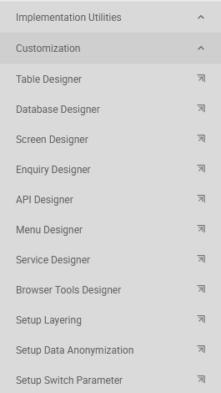
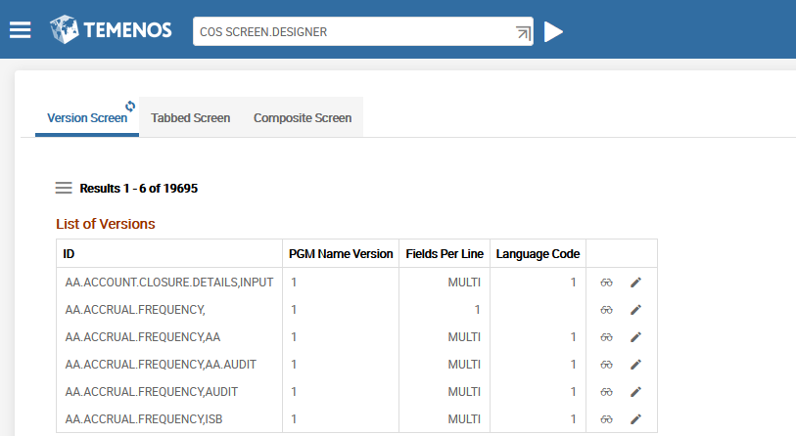
Version Creation with Screen Designer
Executing new version creation or editing existing version:
Menu>Admin Menu>Implementation Utilities>
Customization>Screen Designer
…or from Command Line — via command COS SCREEN.DESIGNER
STEP 1 — Execute Screen Designer from menu
Notes:
Execute Screen Designer from menu (or from Command Line — COS SCREEN.DESIGNER)

Slide 8
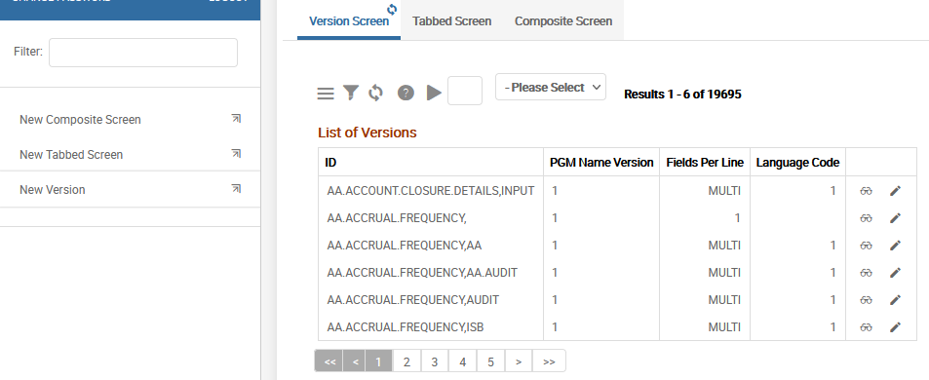
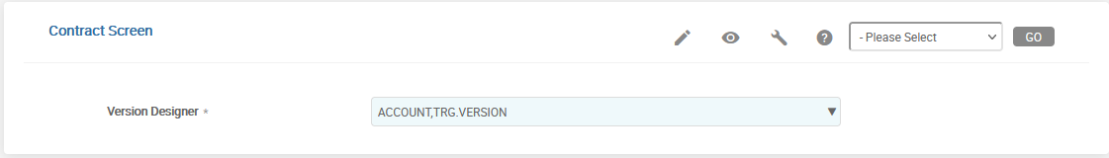
Version Creation with Screen Designer
Executing new version creation or editing existing version:
STEP 4 – Push the button «Edit» (in this case it means – Create new record
STEP 2 – Choose point «New Version»
STEP 3 – Input Version Name
Notes:
Version Designer via Command Line — VERSION,COMPOSITE.VI

Slide 9
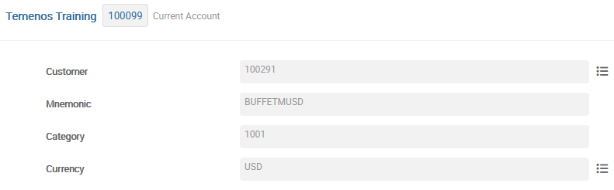
Task 1 - Creation of Versions
Create a version for the ACCOUNT application with the following fields:
Customer Number, Mnemonic, Currency and Category
Version Heading “Temenos Training” to be displayed
Record needs to be authorised by an authoriser
Notes:
This task teaches you how to create a simple version of the ACCOUNT application in T24.
The requirements of the task are listed below:
1. The version must comprise of the following fields of the ACCOUNT application Customer Number, Mnemonic, Currency and Category.
2. The header “Temenos Training” need to be displayed.
3. The customer accounts created should be authorised by another user.

Slide 10
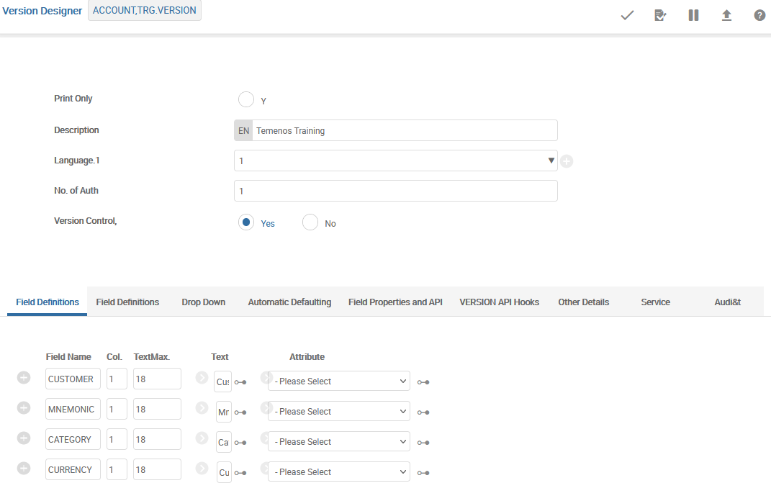
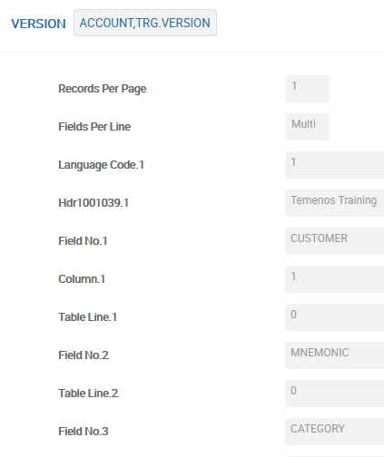
Step 1 - Create The Version
This is how the version looks in application VERSION:

Slide 11
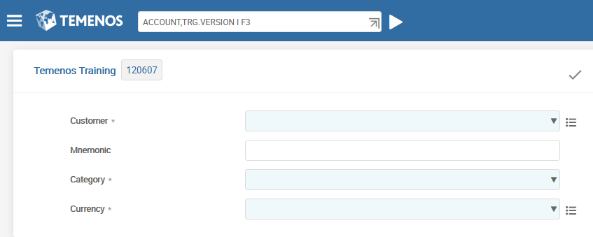
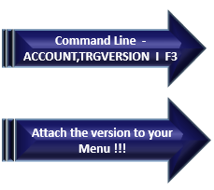
Step 2 – How do we invoke the version created?
Notes:
After you authorise the version record , to launch the version specify the version ID - ACCOUNT,TRG.VERSION1 in the command line.
The version behaves like the under lying application so you can either open a new record or view an existing record using the created Version.
3. You can also launch the version from a menu

Slide 12
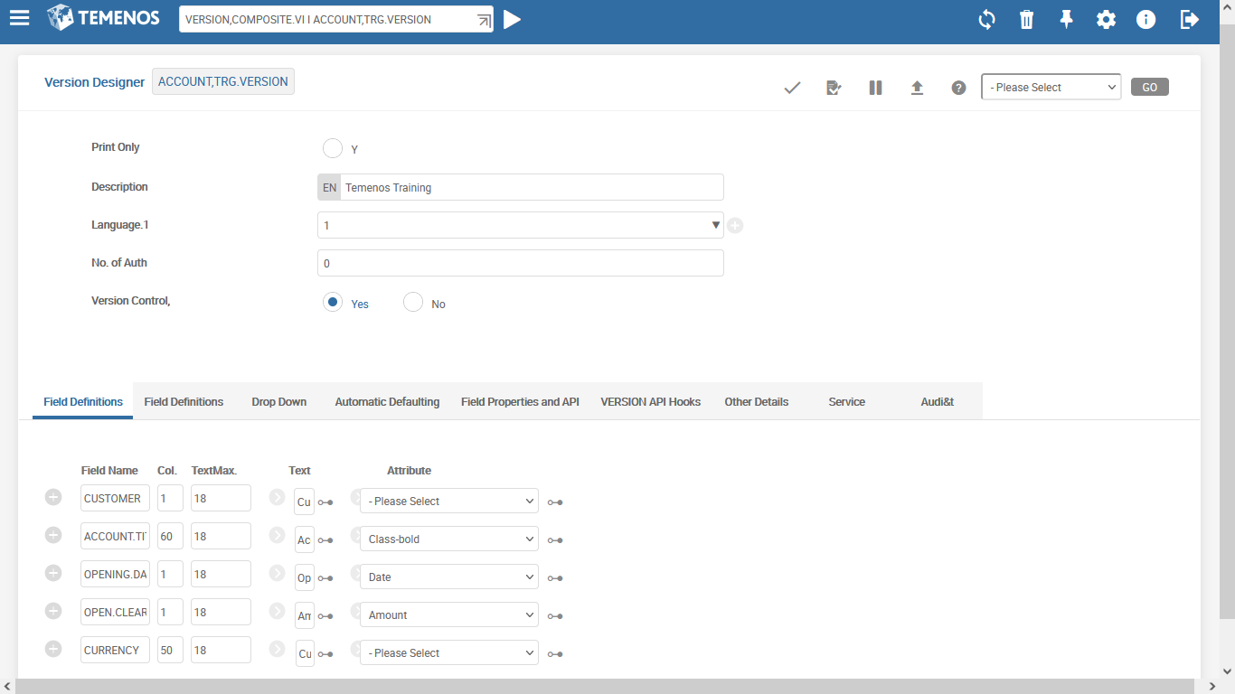
Version Fields
This name will be shown at the top of the version
Should record be authorized or not
Should routines from VERSION.CONTROL be used or not

Slide 13
Version Fields — Field Definitions 1
Technical Name of the field
Field text name
Style attribute
Columns. Number of symbols from left side of the screen
Max size of the field text name

Slide 14
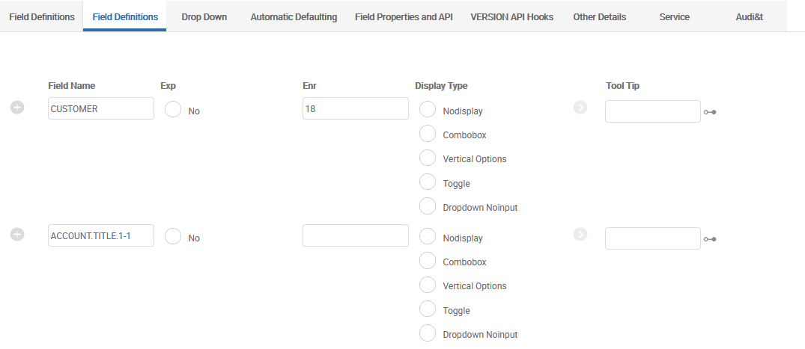
Version Fields — Field Definitions 2
Size of the enrichment field
Technical Name of the field
Pop up tool tip text
Should multivalve fields be expandable or not

Slide 15
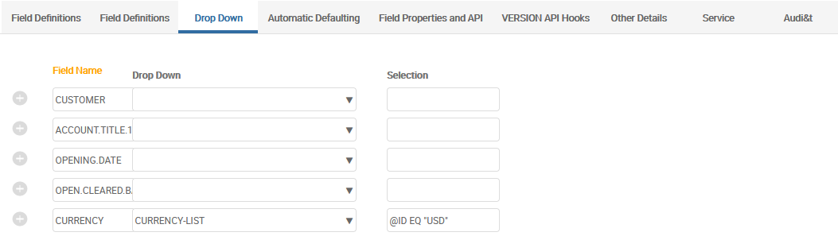
Version Fields — Drop Down
Technical Name of the field
Selection criteria (single parameter). Here could be constant (like ”USD”) or field from this version (technical field name)
Enquiry

Slide 16
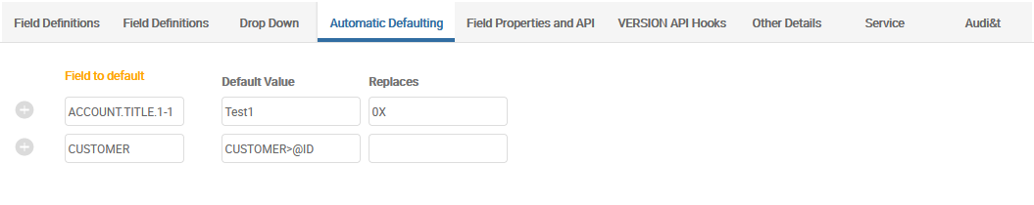
Version Fields — Automatic Details
Technical Name of the field
0X means that any previous symbol will be replaced
This format is used to get data from previous Version (see functionality «Next Version»)

Slide 17
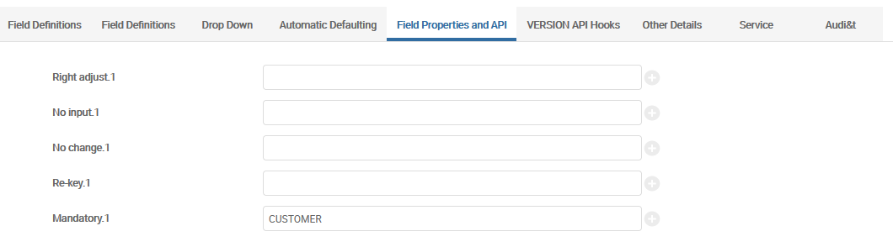
Version Fields — Automatic Details
Field will be adjusted to the right side of the screen
List of no-input fields
List of no-change fields
This enables authorizers to re-enter the data in specific fields so as to re-confirm the entry done by the Inputter.
List of mandatory fields
Notes:
The Rekey field is used in Version at the authorisation level.
This enables authorisers to re-enter the data in specific fields so as to re-confirm the entry done by the Inputter. For example in an FUNDS.TRANSFER application, there are sensitive data like amount, debit account no etc which are entered by an Inputter.
The rekey feature prompts the Authoriser to re-enter the data for confirmation. If the data entered by the Authoriser does not match with the data entered by the Inputter, then the record does not get authorised.
The data for the rekey fields are hidden during authorisation and the Authoriser needs to compulsorily re-enter the information
What happens when a USER who is trying to authorize the record enters incorrect rekey values multiple times ? The system records the number of incorrect rekey attempts by a same authorizer, in a file called EB.REKEY.RETRIES. A record is created in this file whenever a version that contains a rekey field is being authorized. The record id of EB.REKEY.RETRIES would be of the format COMPANY*APPLICATION*RECORD.ID.
The maximum number of incorrect retries allowed for a USER who tries to authorize a record can be restricted using the field NO.OF.RETRIES in SPF application. When this field is left blank, there is no limit set for incorrect rekey attempts.

Slide 18
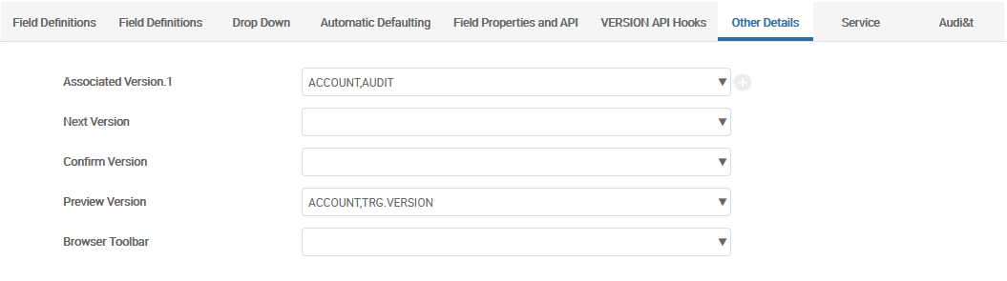
Version Fields — Other details
List of VERSIONs can be associated with the current VERSION in the form of tabs
Preview version will be used to display the transaction when it is successfully completed.
Notes:
A list of VERSIONs can be associated with the current VERSION in the form of tabs
These associated versions must relate to the same application as the version being input

Slide 19
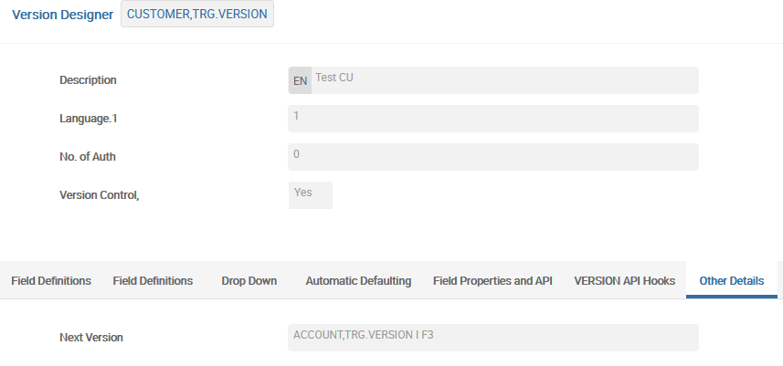
Version Fields — Next Version
CUSTOMER,TRG.VERSION is first version
No. of Auth should be 0 to launch Next Version immediately
This format is used to get data from previous Version
ACCOUNT,TRG.VERSION is second version

Slide 20
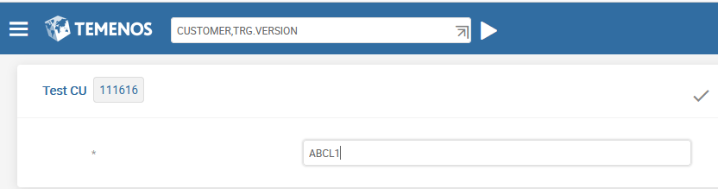
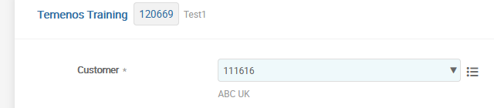
Version Fields — Next Version
CUSTOMER,TRG.VERSION is first version
Next Version will be launched after «Commit»
CUSTOMER field is filled from @ID of previous Version
ACCOUNT,TRG.VERSION is second version

Slide 21
Version Fields
LANGUAGE.CODE
It allows to create Versions for Users with different languages
The order of placing languages in the field 4 defines further the order of languages in text fields for User input and work
For example:
4.1 ENGLISH 4.2 FRENCH
17.1.1 Name 17.1.2 Nom

Slide 22
Version Fields
FIELD.NO (field 13)
Field Number or Field Name
Symbol * allows to add text or empty line
COLUMN (field 14)
Initial position in the line
EXPANSION (field 15)
It allows to limit expansion of multi-fields

Slide 23
Version Fields
TEXT.CHAR.MAX (field 16)
Length of field description (1-39 characters)
Text fields (fields 17-20)
Field description
ENRICHM.CHAR (field 21)
The number of characters displayed in the enrichment
Note: Positions on the screen and fields’ length can be defined only for versions with FIELDS.PER.LINE=MULTI

Slide 24
Task 2 – Version with Multiple Fields Per Line
Create a version for the ACCOUNT application with the following fields
Mnemonic, Customer Number, Currency and Category
Mnemonic and Currency need to be displayed one beside the other
Customer Number and Category need to be displayed one beside the other
All fields to have user defined field names
Hint: The column must be specified when multiple fields are chosen to display in one line
Notes:
The task here teaches you to create version that displays multiple fields in a line.
The requirement of the task is to:
Create a version for the ACCOUNT application with the following fields - Mnemonic, Customer Number, Currency and Category.
The fields Mnemonic and Customer Number need to be displayed one beside the other
The fields Currency and Category need to be displayed one beside the other.
Labels must be user-defined.

Slide 25
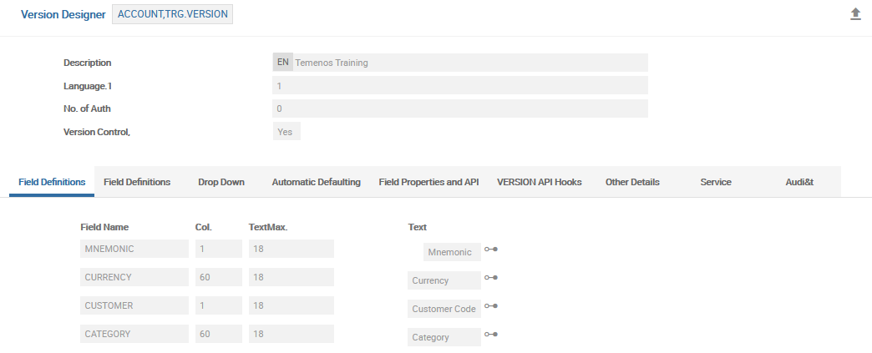
Task 2 – Version with Multiple Fields Per Line
Notes:
The task here teaches you to create version that displays multiple fields in a line.
The requirement of the task is to:
Create a version for the ACCOUNT application with the following fields - Mnemonic, Customer Number, Currency and Category.
The fields Mnemonic and Customer Number need to be displayed one beside the other
The fields Currency and Category need to be displayed one beside the other.
Labels must be user-defined.

Slide 26
Workshop - 1
Create a version for the CUSTOMER application
Name of the version CUSTOMER,XXX (XXX is your initial)
Fields to be displayed:
MNEMONIC
SHORT.NAME
NAME.1
STREET
SECTOR
ACCOUNT.OFFICER
INDUSTRY
TARGET
NATIONALITY
CUSTOMER.STATUS
RESIDENCE
LANGUAGE
Launch your version from Command Line
Attach your version to your menu, launch the menu and check the version
Notes:
Workshop:
Create a version for the CUSTOMER application.
The name of the version will be CUSTOMER,XXX (XXX is your initial)
The Fields that must be part of the version are MNEMONIC,SHORT.NAME,NAME.1,STREET,SECTOR,ACCOUNT.OFFICER,INDUSTRY,TARGET,NATIONALITY,CUSTOMER.STATUS,RESIDENCE,LANGUAGE.

Slide 27
Workshop - 2
Amend the previously created version so that:
A value 1001 is defaulted in the field SECTOR
Make SECTOR a NOINPUT field
A value IN is defaulted in the field NATIONALITY if the previous available value is US
Make CUSTOMER.STATUS a mandatory field
Ensure that the value of ACCOUNT.OFFICER is not changed once the customer record is authorized
Notes:
Amend the previously created version so that
1.1 A value thousand(1001) is defaulted in the field SECTOR
1.2 Make SECTOR a NOINPUT field
1.3 A value IN is defaulted in the field NATIONALITY if the previous available value is US
1.4 Make TEXT a mandatory field
1.5 Ensure that the value of ACCOUNT OFFICER is not changed once the customer record is authorized.

Slide 28
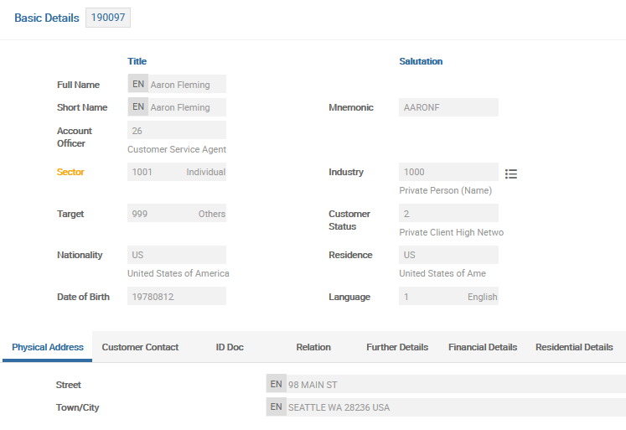
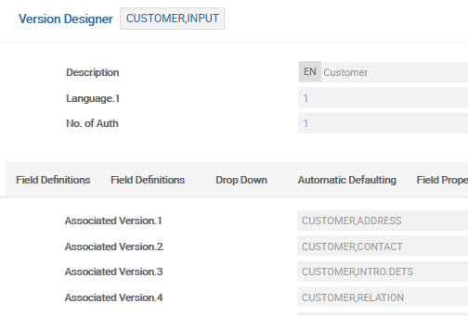
Tabbed Screens in Versions
A list of VERSIONs can be associated with the current VERSION in the form of tabs
These associated versions must relate to the same application as the version being input
Credit
Officer

Slide 29
Tabbed Screens in Versions
ASSOC.VERSION (field 68)
Allows you to distribute data across multiple screens
For example: Contract Details, Settlement Instructions, Audit Information etc.
Access to screens - through tabs, similar to sheets in Excel
In main Version there are references for additional Versions (in field 68 ASSOC.VERSION)
The description of the Tab – in the field 67 DESCRIPTION

Slide 30
Automation and checks using routines (programs)
Routines (programs) can be used in Versions for:
Data input
Fields’ automatic filling
Checks

Slide 31
Thank you for your time and attention!
FORANX LLC
Legal address:
35A, Ponomarenko str., 201 office, Minsk, 220015, Belarus
Tel.:+ 375 17 202 76 78
+ 375 17 202 76 79
Fax: + 375 17 362 34 22
Web-site: www.foranx.by
Minsk, 2021

